Slide 1


Himmler Benitez
April, 2023

Slide 2

Outline
Executive Summary
Introduction
Methodology
Results
Conclusion

Slide 3
Executive Summary
Methodologies
Results
Data was obtained from different sources and methods:
Directly from the Space X API
Web Scraping from Wikipedia
• After the Exploratory Data Analysis, the raw data got processing and standardization, and the application of this methodologies:
Data wrangling,
Data visualization
Interactive dashboard
• Finally, a Machine Learning Prediction model was implemented
ES-L1, GEO, HEO and SSO orbits were the ones with the highest success rates.
SO orbit has a success rate of zero
There is a correlation between PayloadMass and success rate which seems to favor the heavier payloadMass
Decision tree method was the most adequate model to predict the outcomes of the landings

Slide 4
Introduction
Space Y is a new company that intends to compete with space X and is investigating to answers the following problems:
What are the launches with the best successful rate based in the types of boosters and payloads mass?
What is the launch site with the best successful rate?
What is the best approach and method to predict the outcomes of the landings using Machine Learning?

Slide 5

Section 1

Slide 6
Methodology
Executive Summary
Data collection methodology:
Describe how data was collected
Perform data wrangling
Describe how data was processed
Perform exploratory data analysis (EDA) using visualization and SQL
Perform interactive visual analytics using Folium and Plotly Dash
Perform predictive analysis using classification models
How to build, tune, evaluate classification models

Slide 7
Data Collection
Data was collected through 2 methods:
API Request: https://api.spacexdata.com/v4/rockets/
Web Scraping: https://en.wikipedia.org/wiki/List_of_Falcon/_9/_and_Falcon_Heavy_launches

Slide 8
Data Collection – SpaceX API
The data was collected from the SpaceX public API by doing direct request to the public API.
Link
API Request
and parsing the data
Conversion to dataframe
Treating the data

Slide 9
Data Collection - Scraping
Getting the HTML structure from Wikipedia page
Extracting the data from the HTML tables
Creating the dataframe
SpaceX launches data is obtained from Wikipedia through web scraping.
GitHub URL

Slide 10
Data Wrangling
Data was obtained though a CSV file and then analyzed.
Data Wrangling process:
GitHub URL
Analylizing data from CSV
Treating the data
Enriching the dataframe

Slide 11
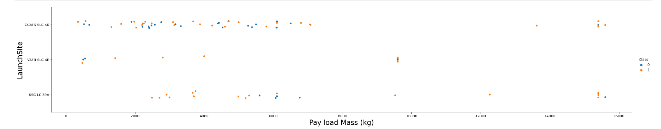
EDA with Data Visualization
The scatterplots and barplots charts plotted were used to explore the relationship between features.
FlightNumber vs. PayloadMass
FlightNumber vs LaunchSite
GitHub URL

Slide 12
EDA with SQL
Performed SQL queries:
The names of the launch sites
Top 5 records where launch sites begin with the string 'CCA’
The total payload mass carried by boosters launched by NASA (CRS)
Average payload mass carried by booster version F9 v1.1
The date when the first successful landing outcome in ground pad was achieved
The names of the boosters which have success in drone ship and have payload mass greater than 4000 but less than 6000
The total number of successful and failure mission outcomes
The names of the booster_versions which have carried the maximum payload mass
The records which will display the month names, failure landing_outcomes in drone ship ,booster versions, launch_site for the months in year 2015
The count of successful landing_outcomes between the date 04-06-2010 and 20-03-2017 in descending order.
GitHub URL

Slide 13
Build an Interactive Map with Folium
Added map objects such as markers, circles, and lines in the folium map
Markers to indicate the launch sites
Circles to highlight coordinates of the launch sites
Color markers to indicate success/failed launches
Lines to indicate distance to the nearest shore and coast
GitHub URL

Slide 14
Build a Dashboard with Plotly Dash
Graphs and plots were used to visualize and explore the date
Percentage of launches per site
Payload range
With those resources, the data can be analyzed in an easy and relevant way to identify the most appropriate launch site based in the payloads.
GitHub URL

Slide 15
Predictive Analysis (Classification)
Data was standardized and split to use it for training and testing the four classification models (Logistic regression, support vector machine, decision tree and K nearest neighbors).
GitHub URL
Data acquisition and standarization
Creation of each classification model
Training the models
Data spliting (Train/Test)
Test the models
Comparasion of the results

Slide 16
Results
Exploratory data analysis results
There are 4 different launch sites for Space X launches
CCAFS SLC 40 is the most used launch site
The first success landing was in 2015
The average payload of F9 v1.1 booster is 2,928 kg
The total payload mass carried by boosters launched by NASA (CRS) was 111268 Kg
98 of out 101 launches were successful

Slide 17
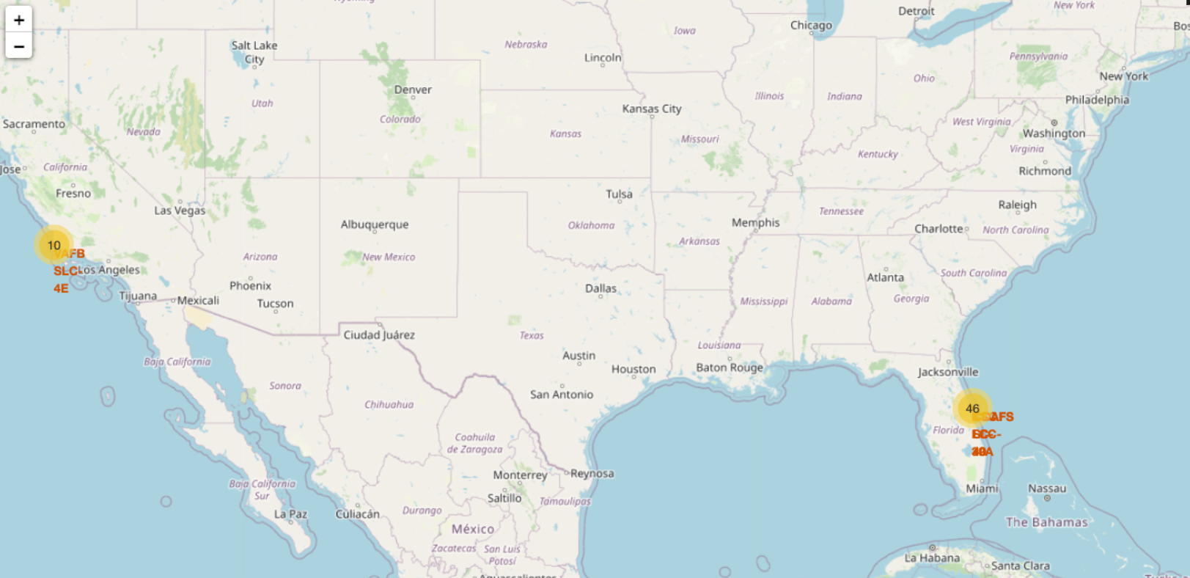
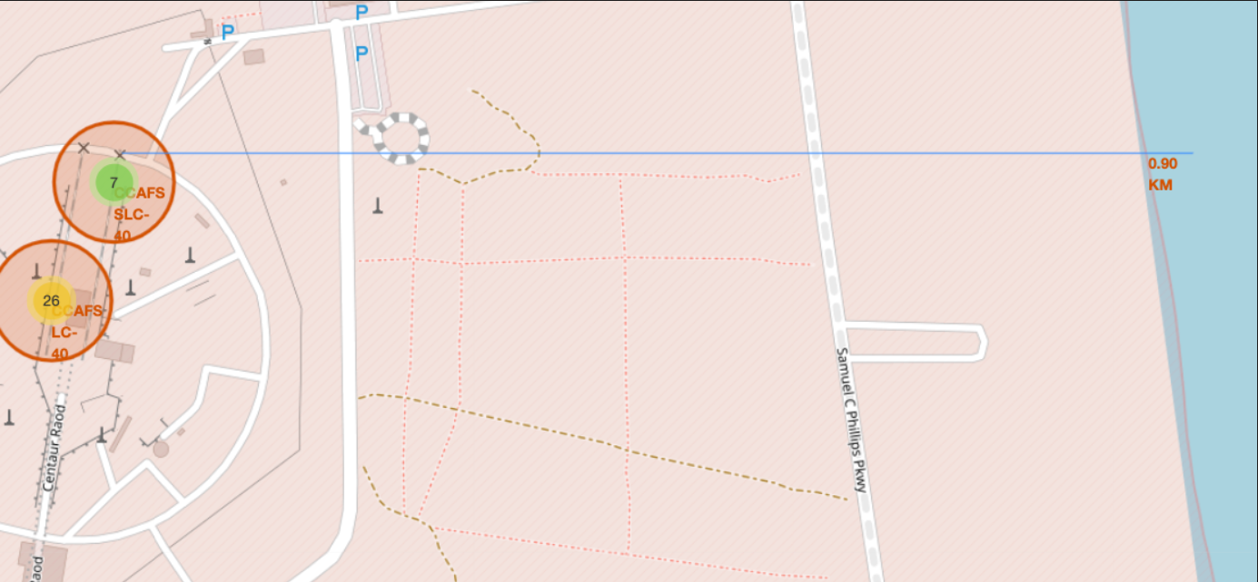
Results
Launch sites were located in the maps with interactive analytics. Finding that the majority of the launches were in the east cost.

Slide 18
Results
Predictive analysis results
Decision tree model was the best model of the 4 with an accuracy of 88%.

Slide 19

Section 2

Slide 20
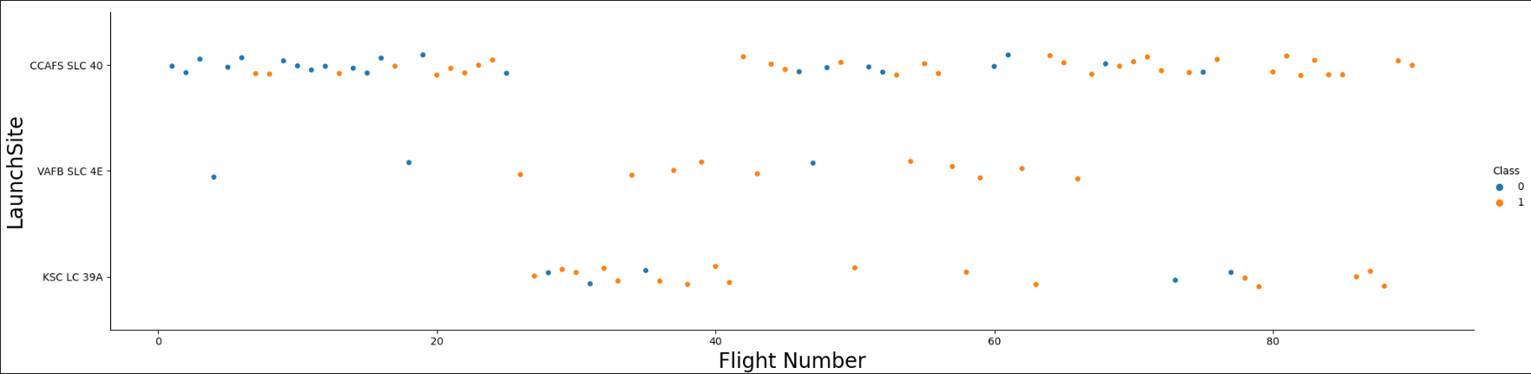
Flight Number vs. Launch Site
Based on the plot, CCAF5 SLC 40 launch site is the most used for the launches and the one with the major successful launches.
VAFB SLC 4E is the launch site with the best success ratio based in the total of launches in there

Slide 21
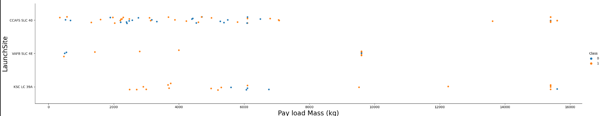
Payload vs. Launch Site
The success ratio for payloads over 8000kg is outstanding
VAFB SLC 4E seems not being suitable, or at least the last option, for heavy payloads
< 8000 kg payloads were the most frequent launches

Slide 22
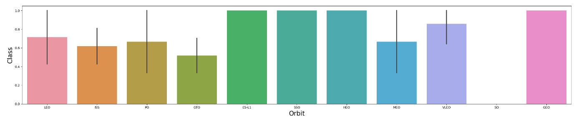
Success Rate vs. Orbit Type
ES-L1, GEO, HEO and SSO orbits were the ones with the highest success rates.
SO orbit has a success rate of zero

Slide 23
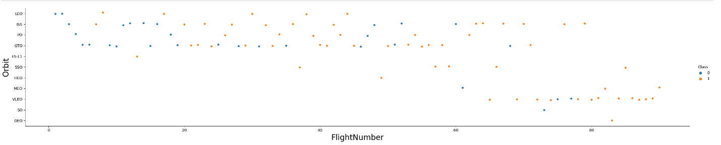
Flight Number vs. Orbit Type
Success rate has improved over time
SO failed its unique flight

Slide 24
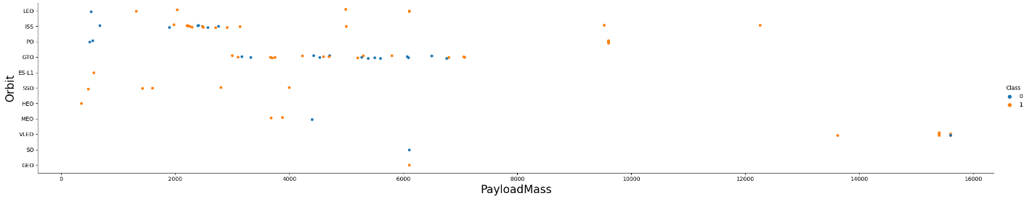
Payload vs. Orbit Type
VLEO orbits has only been flight by high payload mass

Slide 25
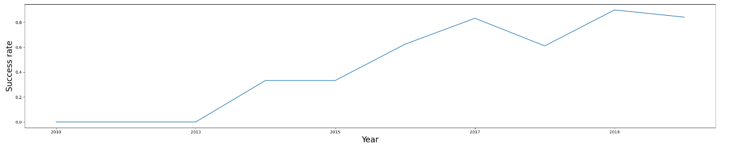
Launch Success Yearly Trend
Success rate improved over time
In 2018, the success rate tendency went down but it recovered next year

Slide 26
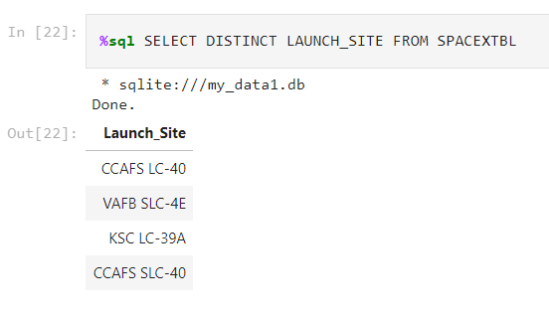
All Launch Site Names
The query allowed to get all the unique launch site names

Slide 27
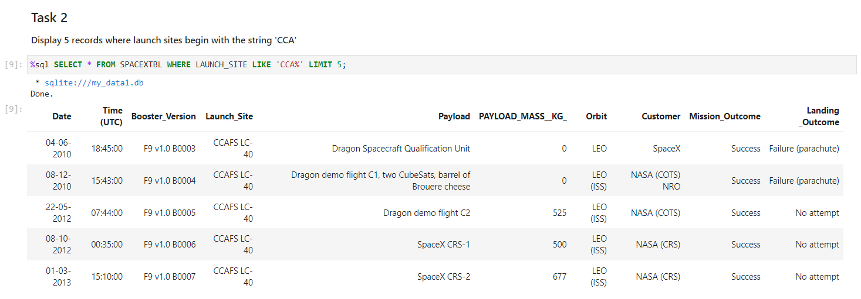
Launch Site Names Begin with 'CCA'
Five simples of CCAFS LC-40 launch site

Slide 28
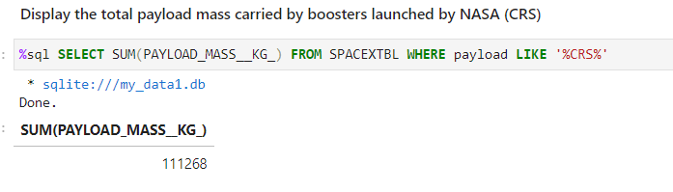
Total Payload Mass
The keyword to sum all the payloads is “CRS” giving a result of 111,268 Kg

Slide 29
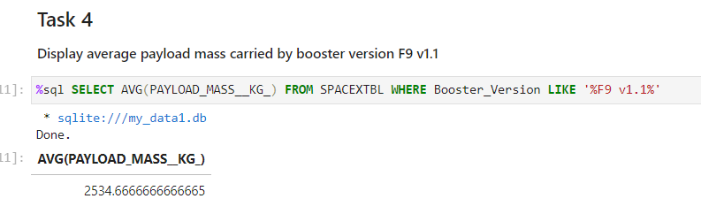
Average Payload Mass by F9 v1.1
The query consult all the record where the Booster Version contains F9 v1.1 and calculate the Average for the payload

Slide 30
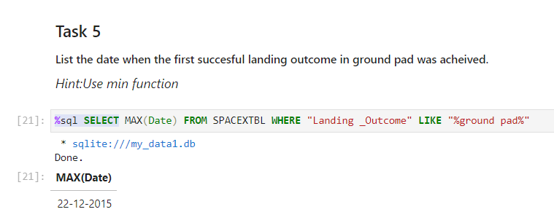
First Successful Ground Landing Date
The first landing was in Dec 2015. The query filters the data with the function MAX

Slide 31
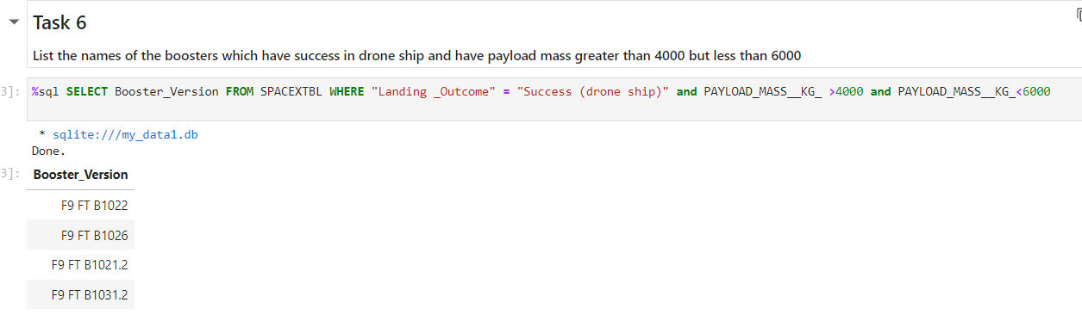
Successful Drone Ship Landing with Payload between 4000 and 6000
All the boosters with a success outcome and payload between 4000 and 6000 are displayed
Two conditions are stablished

Slide 32
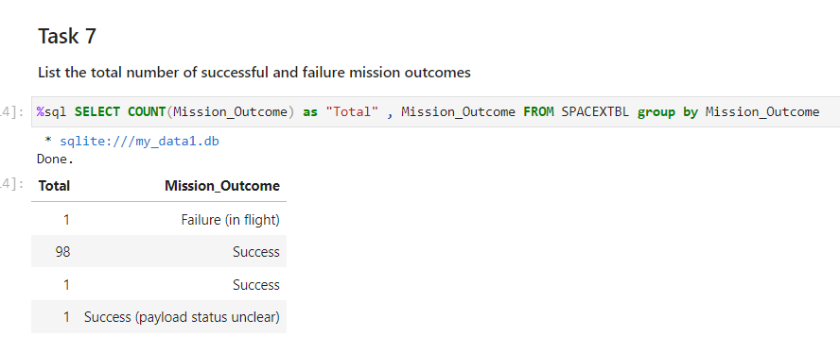
Total Number of Successful and Failure Mission Outcomes
To calculate the total number of the outcomes, the data was grouped

Slide 33
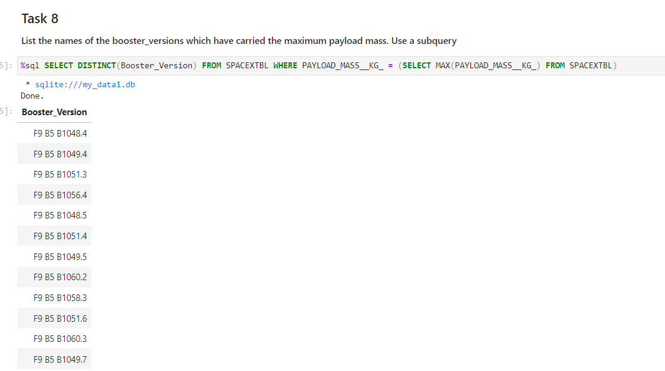
Boosters Carried Maximum Payload
All these boosters carried the maximum payload mass

Slide 34
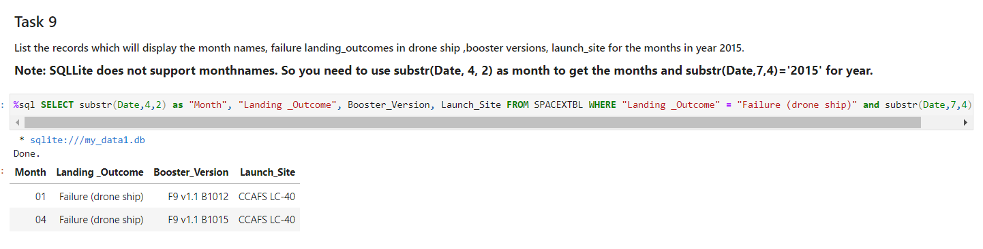
2015 Launch Records
Only two landing failed in 2015

Slide 35
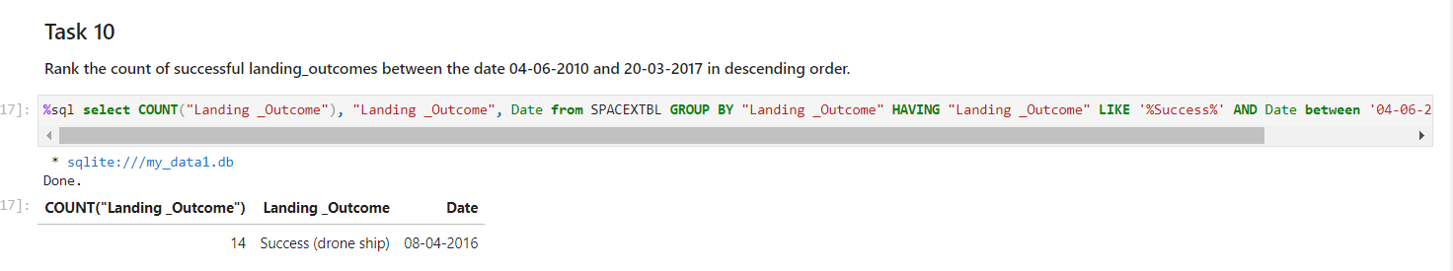
Rank Landing Outcomes Between 2010-06-04 and 2017-03-20
14 successful landing outcomes were registed in the given timeframe

Slide 36

Section 3

Slide 37
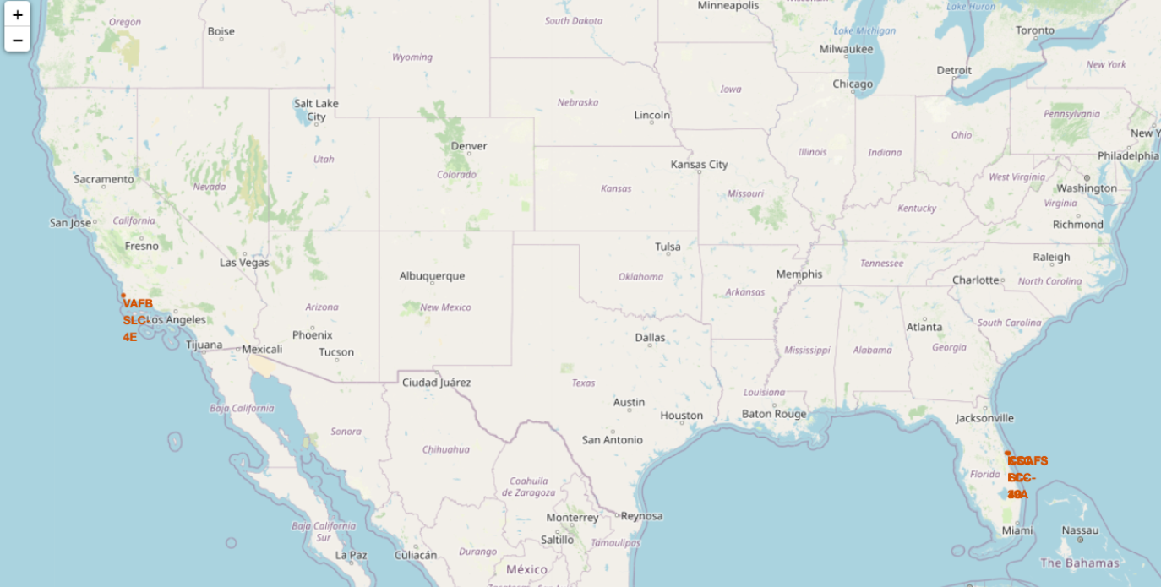
All launch sites in the global map
The launch sites are place on the west and east coast of US

Slide 38
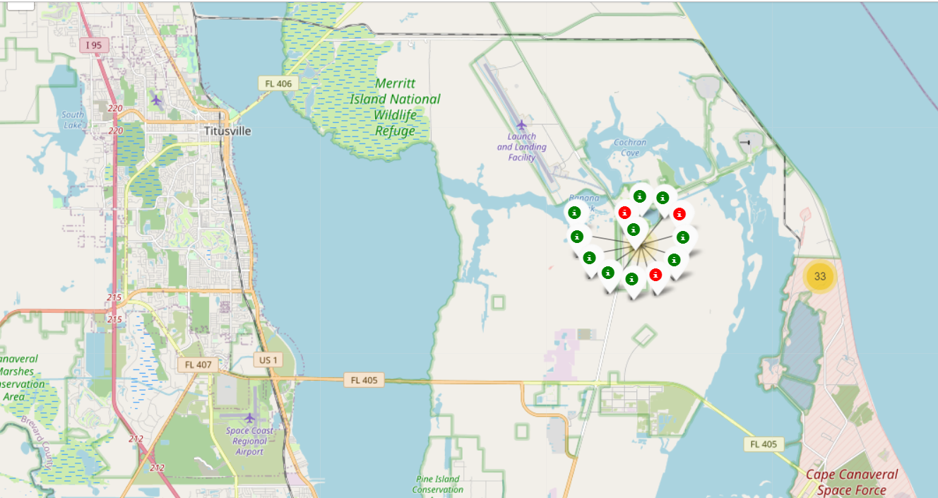
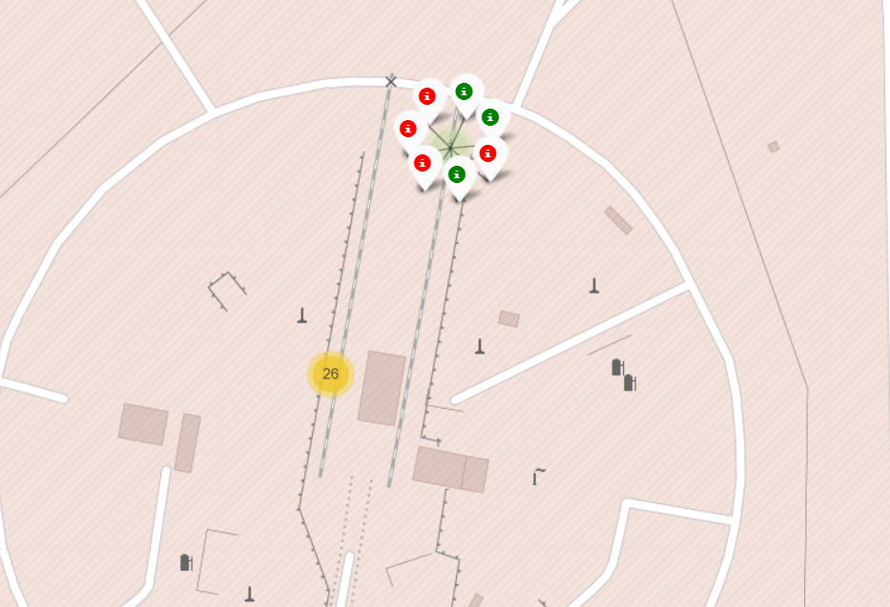
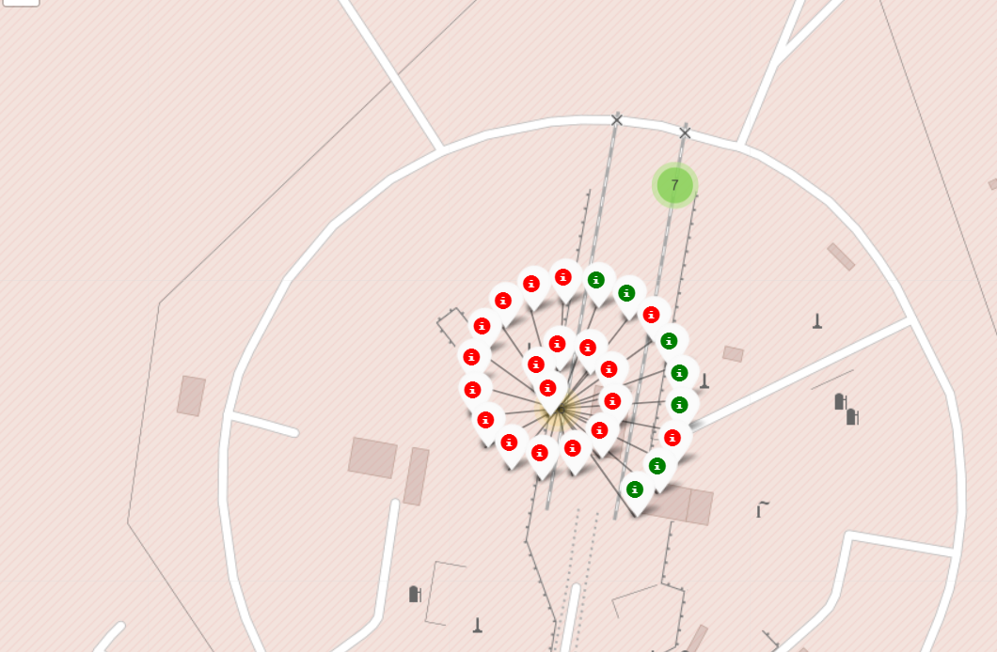
Color-labeled by launch outcomes
The green labels are successful launches
The red labels are unsuccessful launches

Slide 39
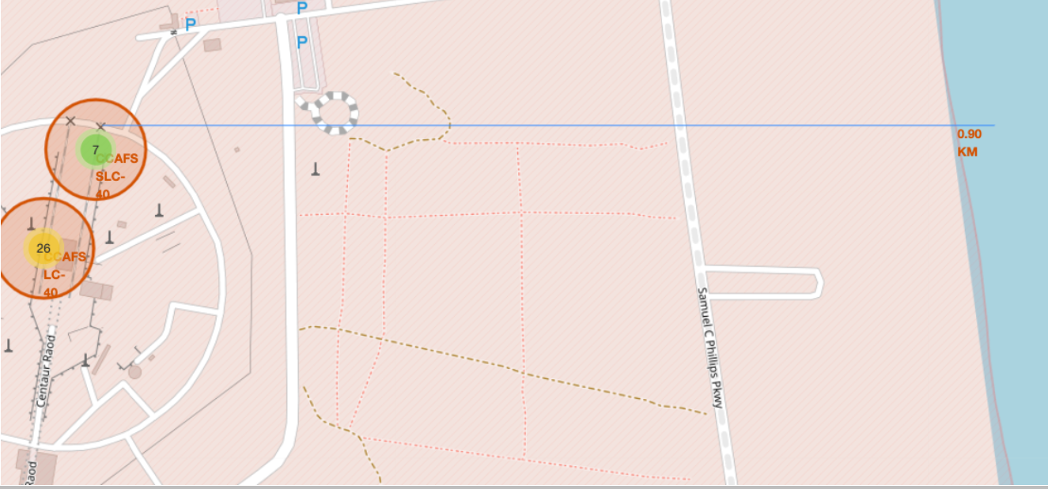
<Folium Map Screenshot 3>
CCAFS SLC-4O is less than 1 km near the beach

Slide 40

Section 4

Slide 41
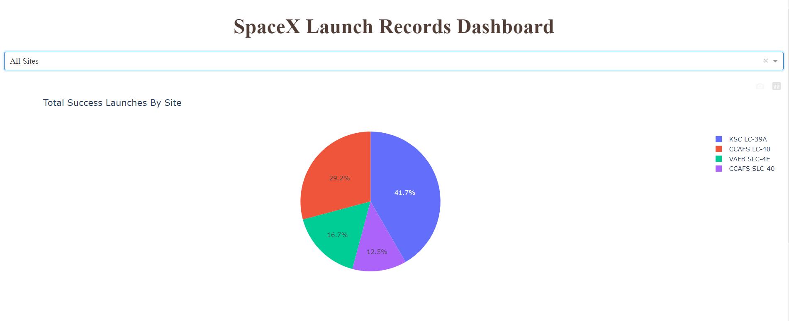
Successful launches ratio by sites
KSC LC-39A has the best success ratio for launches of all the launches sites

Slide 42
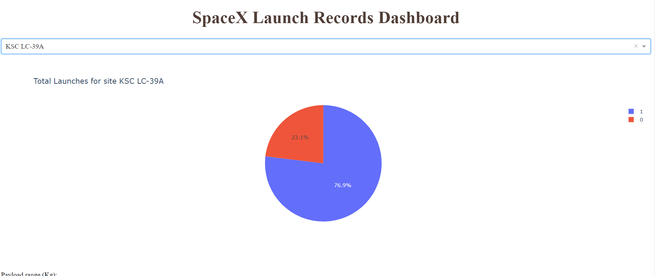
Launch site with the highest success ratio
This launch site has a 76.9% success ratio

Slide 43
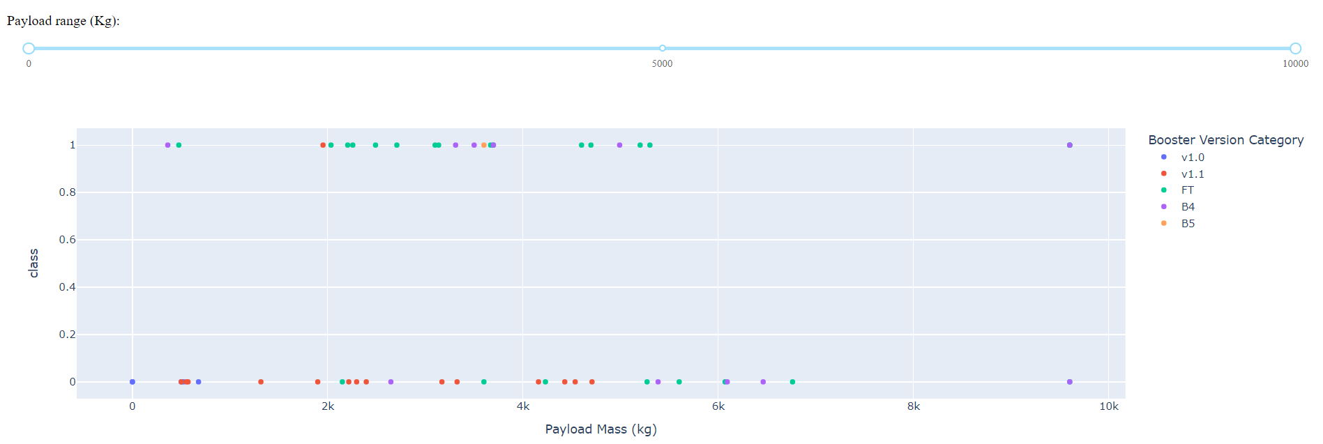
Successful launches per payload mass and booster version
The payload mass between 2000 and 5000 are the most launched and the most successful

Slide 44

Section 5

Slide 45
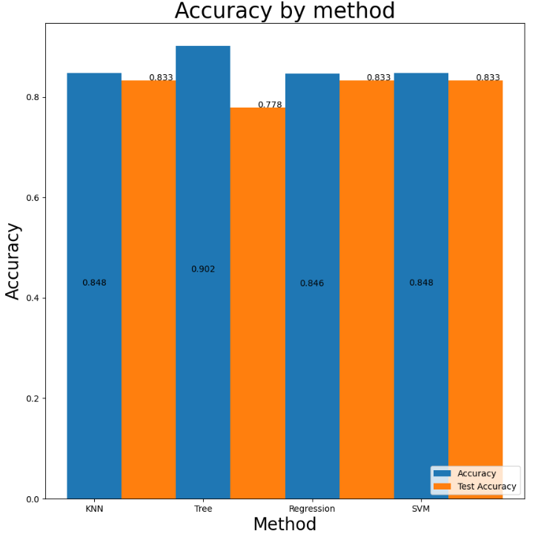
Classification Accuracy
Decision Tree got the best accuracy with 90%

Slide 46
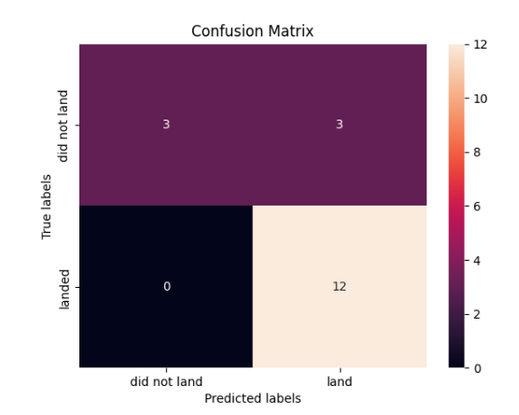
Confusion Matrix
The confusion matrix shows that the decision tree method has predicted correctly the majority of the predictions

Slide 47
Conclusions
Decision tree method was the most adequate model to predict the outcomes of the landings
Data was obtained from different sources and methods
Directly from the Space X API
Web Scraping from wikipedia
ES-L1, GEO, HEO and SSO orbits were the ones with the highest success rates.
SO orbit has a success rate of zero
There is a correlation between PayloadMass and success rate which seems to favor the heavier payloadMass

Slide 48


